Slide 1



SMART INDIA
HACKATHON 2026
TITLE PAGE
Problem Statement ID –SIH26131
Problem Statement Title- Early detection and management of crop diseases and pest infestations
Theme- Agriculture , FoodTech & Rural Development
PS Category- Software
Team ID-125796
Team Name –SIH Beginners

Slide 2
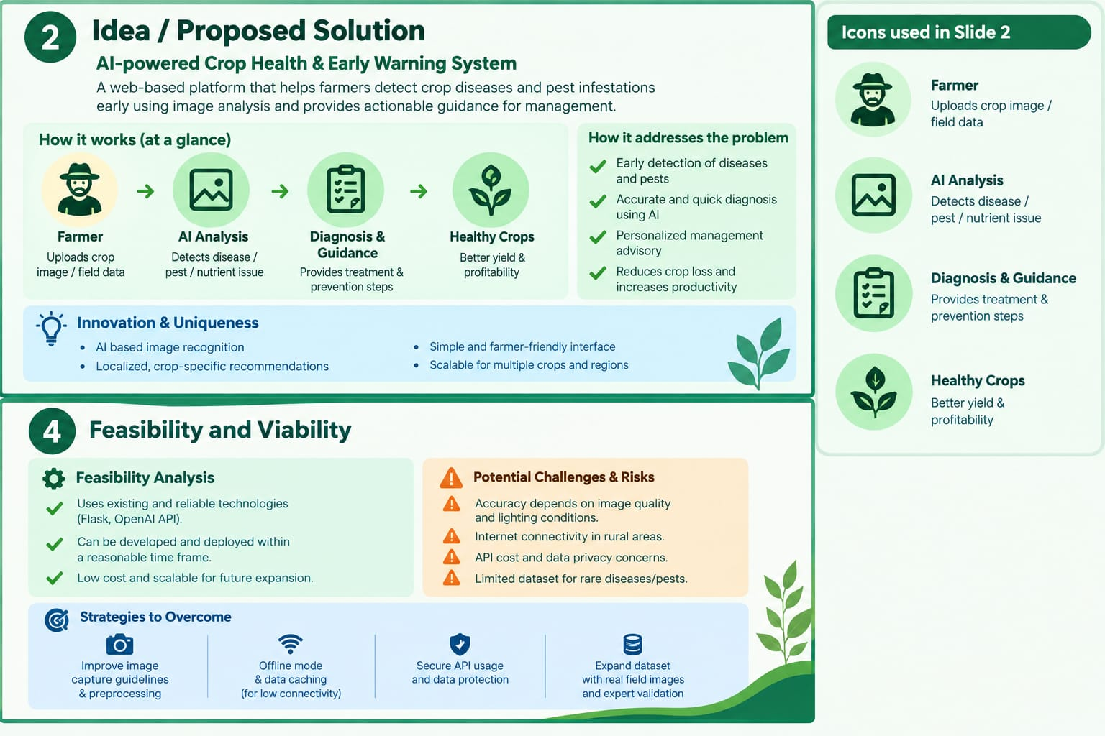

AI powered crop health & Early warning system a web based platform that helps farmers detect crop diseases and pest infestations early using image analysis and provides actionable guidance for management
SIH Beginners
PROPOSED SOLUTION

Slide 3
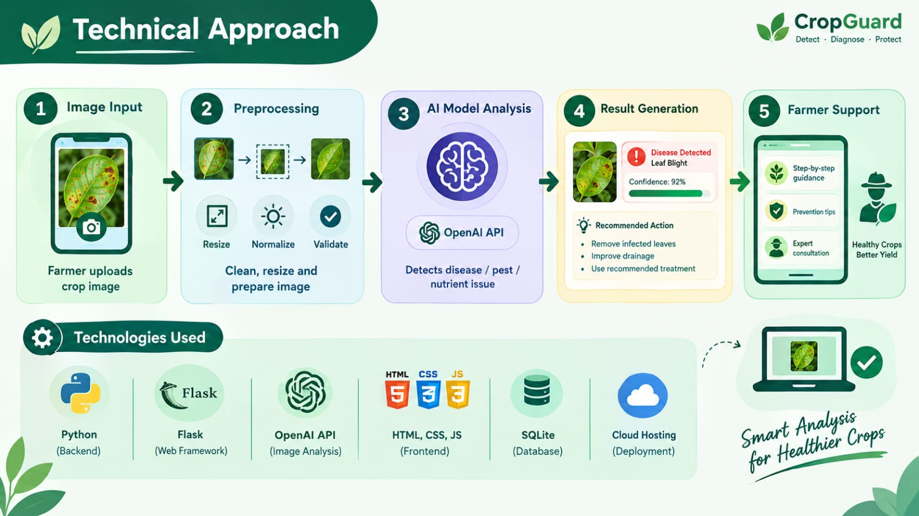
SIH Beginners
TECHNICAL APPROACH
Technology used

Slide 4
SIH Beginners
FEASIBILITY AND VIABILITY

Slide 5
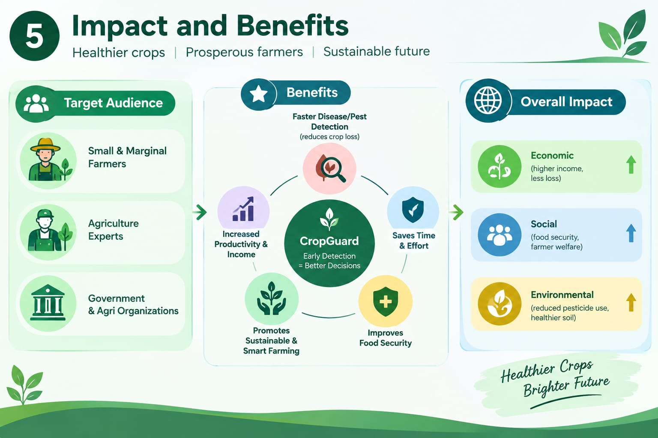
SIH Beginners
IMPACTS AND BENEFITS

Slide 6
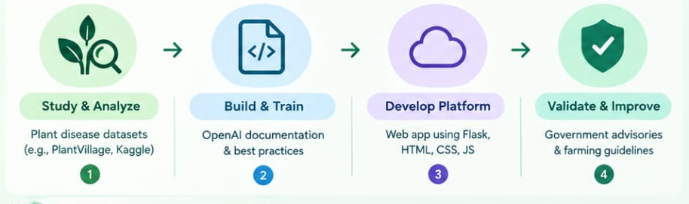
RESEARCH AND REFERENCES
SIH Beginners
1. Research & Datasets:
• PlantVillage & ICAR Datasets: Used for training computer vision models for crop leaf disease detection.
• IEEE / Springer Literature: Standard CNN/Vision Transformer architectures for early pest infestation classification.
• Open-Meteo & ISRO Bhuvan API: Agro-climatic data for predictive pest outbreak modeling.
2. Competitive Analysis & Unique Differentiator:
• Benchmark Apps: Plantix, Agrio.
• Our Key Advantage: Offline-first image inference, localized pest alerts in Marathi, and direct integration with local Agriculture Department advisories.
3. Government & Policy Alignment:
• Aligned with Digital Agriculture Mission (Government of India/Maharashtra).
• Supports UN Sustainable Development Goal (SDG 2: Zero Hunger & Sustainable Agriculture).

